Slide 1

Secure From Scratch
Secure From Scratch
With security in mind,
From the first line of code

Slide 2

After this workshop
Write code with less security vulnerabilities

Slide 3





Notes:
Until recently, I was a developer and not very concerned about security. Which means my code had zero security problems.

Slide 4

…remotely playing recorded videos…
…unsanitized user input
Notes:
Since I met Or, I started to learn about the world of security.
One day we researched an open-source surveillance solution that allows remote access to cameras and recordings.
The solution contained a feature that remotely allowed playing recorded videos using your default media player.
It was implemented by concatenating unsanitized user input to an OS command and executing that.

Slide 5

Notes:
I was shocked.
This was a smart developer. He wrote a great commercial quality product by himself.
Doesn’t he know never to use unsanitized user input?
But, then again, I shouldn’t be surprised. Many developers never learn about security.

Slide 6
Demo
Notes:
https://github.com/ispysoftware/iSpy/blob/eb0094c49ef9545ee52d4a0eeadb5acd71730fe9/Server/LocalServer.cs
https://medium.com/@securylight/ispy-c86019163cc1

Slide 7
string fn = GetVar(sRequest, "fn"); ... case "playfile": { try { string subdir = Helper.GetDirectory(otid, oid); string filename = Helper.GetMediaDirectory(otid, oid); ... filename += subdir + @"\" + fn; try { Process.Start(filename);
Request URL
Notes:
https://github.com/ispysoftware/iSpy/blob/eb0094c49ef9545ee52d4a0eeadb5acd71730fe9/Server/LocalServer.cs
https://medium.com/@securylight/ispy-c86019163cc1

Slide 8
sRequestedFile = sRequest.Substring(iStartPos); … sPhysicalFilePath = (sLocalDir + sRequestedFile).Replace("%20", " ").ToLower(); var bHasAuth = sPhysicalFilePath.EndsWith("crossdomain.xml") || CheckAuth(sPhysicalFilePath);
Request URL
Notes:
https://github.com/ispysoftware/iSpy/blob/eb0094c49ef9545ee52d4a0eeadb5acd71730fe9/Server/LocalServer.cs
https://medium.com/@securylight/ispy-c86019163cc1

Slide 9
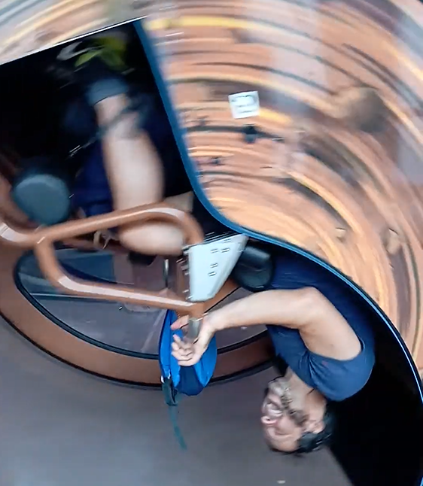
Yariv Tal
University lecturer
Bootcamps mentor
Seasoned developer
Application security researcher
Drug of choice: Roller coasters

Slide 10

Or Sahar
Security researcher
Secure code Influencer
Application security consultation and PT
A veteran developer
Drug of choice : Snowy mountains
Notes:
My name is Or Sahar.
I was a developer and developer team lead for many years.
A few years ago, at the age of 40, I switched to application security consultation and penetration testing.
Later on, I focused on application security research.
Today I’m a senior security researcher.
My drug of choice is chasing CVES, and climbing snowy mountains.

Slide 11
Getting to Know You
Backend/Front end?
Java/C#/Python/C++/NodeJS/Typescript/Other?
Experience?
Security knowledge?
i++ or ++i?

Slide 12
What Is This Workshop About?

Slide 13
This is a Secure Programming Workshop
It’s a mindset
Can be applied to any programming language
Programming, nothing more.
Not SDLC, Secure By design, Threat modeling etc.

Slide 14
What is Secure Programming?
Programming that leads to less Security Bugs
Secure coding is … developing computer software in such a way that guards against the accidental introduction of security vulnerabilities.
Defects, bugs and logic flaws are consistently the primary cause of commonly exploited software vulnerabilities.
… most vulnerabilities stem from a relatively small number of common software programming errors.
Wikipedia

Slide 15
What is a Security Bug?
A bug that leads to a security vulnerability.

Slide 16
What is a Security Vulnerability?
So many (incomplete) definitions!
In OWASP We Trust:
A vulnerability is a hole or a weakness in the application .. that allows an attacker to cause harm to the stakeholders of an application.
Stakeholders include the application owner, application users, and other entities that rely on the application.

Slide 17
The Goal of Secure Programming
Less Security Bugs
→ Less Vulnerabilities
→ Less Exploitations
→ Less Harm

Slide 18
The Goal of Secure From Scratch
Involve in the developers’ careers ASAP
Make Secure Programming the default
Form good habits

Slide 19
PREVENT - SFS Principles
Priority/Privacy/Permissions
Reporting & logging
Easy to use securely
Verify
Errors & exceptions
Neat code
Trust Boundaries

Slide 20
Workshop Outline
The Need for Secure Coding
Getting To Know The Lab Environment
Hacking is Unexpected Input
And Then There Was Mongodb
Summary

Slide 21
Part 1: The Need
Notes:
There are many articles and courses that explain the cost of vulnerabilities
in this workshop we’ll not elaborate about it.
if you find it’s interesting to to jfgi.com

Slide 22
Cost of Vulnerabilities - 2023
MOVEit
$9,923,771,385
1000 organizations
60,144,069 individuals
Root cause is SQL injection.
Notes:
MOVEit has a group of products that offer secure and compliant ways to transfer sensitive data between partners, customers, users, and systems
. On may 2023 the vulnerability was disclosed by security firm and already exploited in the wild.
The mass-exploitation of MOVEit Transfer software has rapidly cemented itself as the largest hack of the year so far.
While the full impact of the attack will likely remain untold for months to come,
there are now more than 1,000 known victims of the MOVEit breach, according to cybersecurity company Emsisoft.
This milestone makes the MOVEit breach not just the largest hack of 2023 — but also one of the largest in recent history.
The root cause of MOVEit mass-exploitation is sql injection.

Slide 23
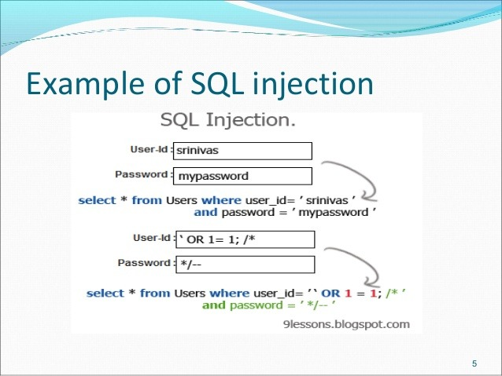
SQL Injection
SQL Injection occurs when an attacker is able to insert a series of SQL statements into a 'query' that an application will execute on its database

Slide 24
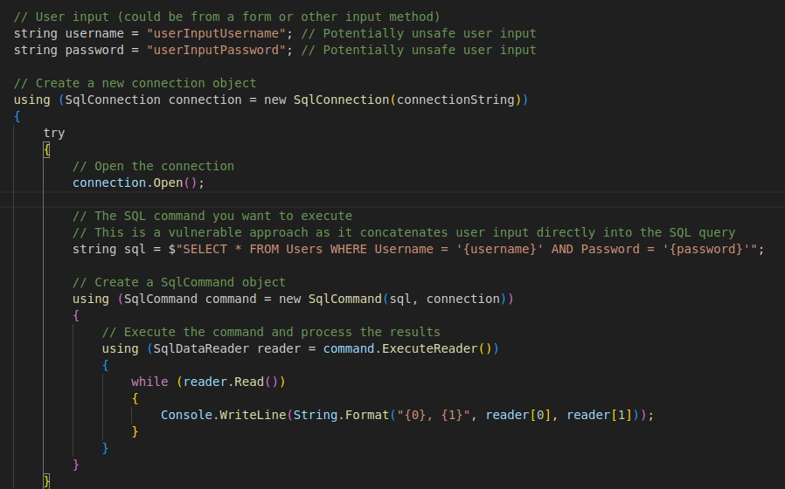
SQL Injection

Slide 25
Part 2: Getting To Know The Lab Environment

Slide 26
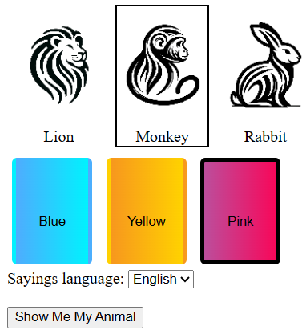
Case In-Point – The Animals Game
Webservice
Users get a webpage with selection:
Animal (lion/rabbit/monkey)
Color (blue, yellow, pink)
After clicking button user sees:
Animal image
Short quips matching the animal

Slide 27
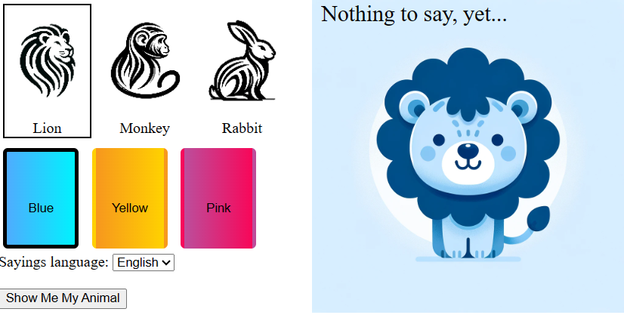
Case In-Point – The Animals Game
Example:
Blue Lion

Slide 28
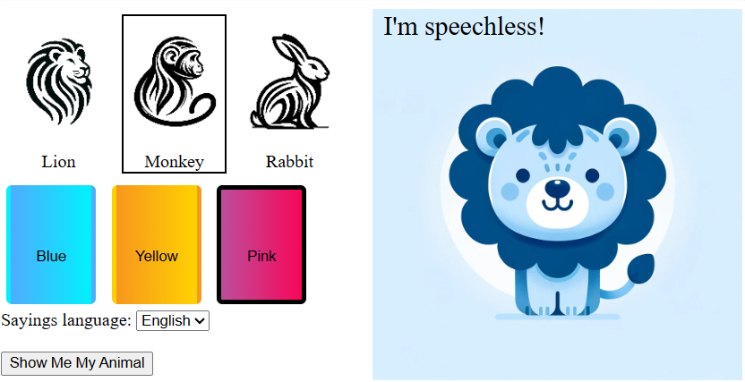
The Animals Game – Current State
Example:
Pink Monkey

Slide 29

LAB: Setting up the environment
5 min
In a browser go to: https://github.com/SecureFromScratch/Workshops
Download and extract the animals_sql release zip file
Open the folder with your ide
Create a virtual environment + install requirements
Execute the program
Surf to http://localhost:5001/public/index.html
IMPORTANT: Do not look in the spoilers folder!

Slide 30






Walkthrough: Architecture
public
blue
lion.webp
browser
fetch()
fastapi
+ sqlalchemy
+ app code
animals.py
monkey.webp
rabbit.webp
yellow, monkey
yellow
monkey.webp, [ text1, text2 ]
lion.webp
readfile
monkey.webp
rabbit.webp
select * from
pink
[ entry1, entry2 ]
lion.webp
monkey.webp
rabbit.webp

Slide 31
Walkthrough: Supported API
Get all animals: http://localhost:5001/api/animals
Get languages: http://localhost:5001/api/languages
Get animal image: http://.../api/myanimal?color=pink&imgName=lion.webp
Get animal text quips: Use POST: localhost:5001/api/animalsays + JSON body: {“langTable”: “english”, “color”: “blue”, “animal”: “rabbit” }

Slide 32
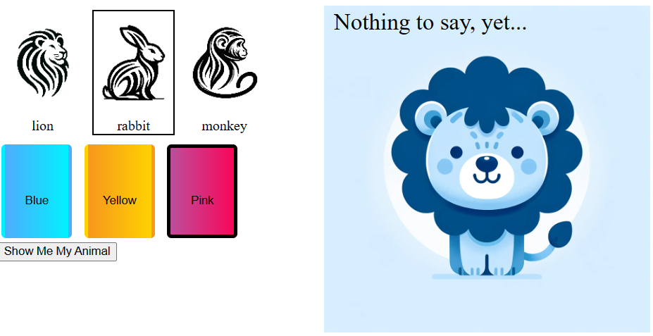
The Animals Game – Current State
Example:
Pink Monkey

Slide 33
Walkthrough: /api/myanimal?color=…&imgName=
@app.get("/api/myanimal")
async def get_animal_image(color: str, imgName: str):
# TODO: Build path to image ...:
# { color: <color>, imgName: <imgNameWithExtension> }
image_path = 'public/blue/lion.webp’;
...
return FileResponse(image_path)

Slide 34
LAB: Implement missing logic
10 min
Implement myanimal to return correct image
IMPORTANT: Do not look in the spoilers folder!

Slide 35
Part 3: Hacking is Using Unexpected Input

Slide 36
Is Writing Secure Code Hard?

Slide 37
Input is a Problem
What We KNOW is Possible
Valid User Input
What IS Possible
What IS Possible
What IS Possible

Slide 38
Solution: Control the Input
SIDE BAR: LangSec
Treat all inputs as formal languages and parse them with rigorous, mathematically precise parsers.
SIDE BAR: LangSec
What We KNOW is Possible
=
What IS Possible
Valid User Input
What IS Possible
What IS Possible

Slide 39
So, Writing Secure Code Is Easy!
Or is it?
There Are So Many Ways To Manipulate Input
There Are So Many Way To Get Secure Coding Wrong!

Slide 40
Manipulating Input – How?
Write my own HTTP client
Use Postman
Change HTML in browser
…

Slide 41
AI Code: /api/myanimal?color=…&imgName=…
@app.get("/api/myanimal")
async def get_animal_image(color: str, imgName: str):
# TODO: Build path to image according to parameters...
# { color: <color>, imgName: <imgNameWithExtension> }
image_path = os.path.join('public', color, imgName) ...
return FileResponse(image_path)
Notes:
both chatgpt4 and gemini
chatgpt was a little worse: const imagePath = `public/${color}/${imgName}`;

Slide 42
PREVENT - Security Is The First Priority
Clearly for AI…
Security is NOT the First Priority

Slide 43
AI Code: Is It Secure?
Gemini | ChatGPT 4
Path/Directory Traversal | Directory Traversal Attack
File Type Validation (.webp) | File Exposure

Slide 44
AI: Secure Coding Suggestions
Gemini | ChatGPT 4
 | Validate Input (block ../)
Sanitize User Input (block ../) | Sanitize Input (block ../)
Input Validation (whitelisting) | Use Safe List (of values)
Restrict Access (Autherized Users) | Access Control
 | Store Public Files Separately

Slide 45
AI Code: Rewrite the code to make it secure
A Welcome-List Approach
@app.get("/api/myanimal")
async def get_animal_image(color: str, imgName: str):
# Validate color and imgName contain only # alphanumeric characters and underscores/dashes
if not re.match(r'^[a-zA-Z0-9_-]+$', color) or not re.match(r'^[a-zA-Z0-9._-]+$', imgName):
raise HTTPException( status_code=status.HTTP_400_BAD_REQUEST, detail="Invalid input")
Reasonable, but not amazing
Notes:
Cumbersome
Easy to forget to do
Duplication of RegEx
Can still access “green”, “rat.webp”, “ids/john_doe.webp”, “funday/programmers_team.webp”

Slide 46
AI Code: Rewrite the code to make it secure
... base_directory = Path('..', 'public')
safe_path = base_directory / color / imgName
# Ensure the path is still within intended directory
if not base_directory in safe_path.resolve().parents:
raise HTTPException( status_code=status.HTTP_403_FORBIDDEN, detail="Access denied")
return FileResponse(str(safe_path))
Reasonable, but not amazing
Notes:
resolve() allows following links
+ Same as on previous slide:
Cumbersome
Easy to forget to do
Duplication of RegEx
Can still access “green”, “rat.webp”, “ids/john_doe.webp”, “funday/programmers_team.webp”

Slide 47
PREVENT – Easy To Use Safely
app = FastAPI(lifespan=on_startup)
sandbox = Sandbox('public’)
...
async def get_animal_image(color: str, imgName: str):
... image_path = sandbox.join('public', color, imgName);
# was os.path.join('public', color, imgName)
return FileResponse(image_path)
Better, but not perfect
Notes:
Can still access “green”, “rat.webp”, “ids/john_doe.webp”, “funday/programmers_team.webp”

Slide 48
Nothing’s Perfect?
Previous secure code was “ok”, but not perfect.
User’s can still send “green” or “rat.webp”
What if we need to prevent user “invented” values?

Slide 49
Part 4: and then there was sql…

Slide 50
Walkthrough: /api/animals
@app.get("/api/animals")
async def get_animals(session: AsyncSession = Depends(get_async_session)):
animals_query = sqlalchemy.text( f"select * from {ANIMALS_COLLECTION}")
animals = await execute_query(session, animals_query)
logging.info(f'animals returns: {animals}')
return animals

Slide 51
Walkthrough: /api/animalsays
@app.post("/api/animalsays")
async def get_animal_saying(request: Request, session:…):
... sayings_query = sqlalchemy.text(
f"select * from {ENGLISH_COLLECTION} "
f"where animalId='lion' and color='blue'")
found = await execute_query(session, sayings_query)
... to_send = [{"text": "I'm speechless!"}, …]
return to_send

Slide 52
LAB: Implement missing logic
10 min
Implement animalsays to retrieve animal “sayings” from sqlite and return them
IMPORTANT: Do not look in the spoilers folder!

Slide 53
Gemini Code: /api/animalsays
async def get_animal_saying(request: Request, session: …):
... langTable = body.get("langTable") color = body.get("color") animalId = body.get("animalId")
sayings_query = text(f"select * from {langTable} “ f"where animalId='{animalId}' and color='{color}'")
found = await execute_query(session, sayings_query)
# Process data from 'found' and assign to 'toSend’
...
to_send = []
for row in found:
# Assuming 'text' is a column in your table
to_send.append({"text": row["text"]})
SQL Injection
SQL Injection
SQL Injection
Notes:
this is chatgpt4
gemini is again worse

Slide 54
Gemini Code: /api/animalsays
async def get_animal_saying(request: Request, session: …):
... to_send = []
for row in found:
# Assuming 'text' is a column in your table
to_send.append({"text": row["text"]})
return to_send
Notes:
this is chatgpt4
gemini is again worse

Slide 55
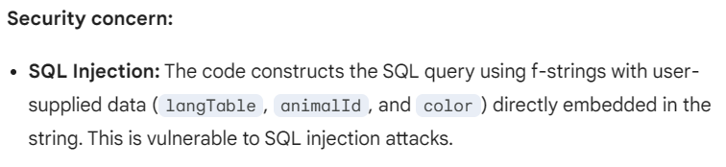
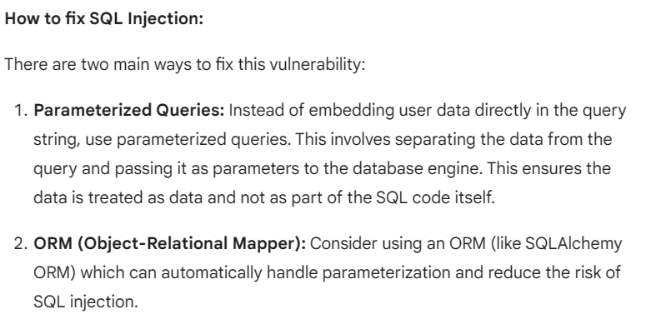
Gemini (AI) Code: Is It Secure?
Notes:
both tell me there’s no input validation and that this is dangerous.
both mention possible nosql injection.
----
chatgpt also thinks there is no error handling (and is wrong – that’s what wrap_with_mongodb_boilerplate does).
----
chatgpt add a lot of correct, but irrelevant data:
- should set database permissions to only allow authorized apps to access database.
- returned values from database might contain pii
- should use https and not http

Slide 56
Gemini (AI) Code: Is It Secure?
Notes:
both tell me there’s no input validation and that this is dangerous.
both mention possible nosql injection.
----
chatgpt also thinks there is no error handling (and is wrong – that’s what wrap_with_mongodb_boilerplate does).
----
chatgpt add a lot of correct, but irrelevant data:
- should set database permissions to only allow authorized apps to access database.
- returned values from database might contain pii
- should use https and not http

Slide 57
Gemini Code – Can Gemini Fix It?
async def get_animal_saying(request: Request, session: …):
... langTable = body.get("langTable") color = body.get("color") animalId = body.get("animalId")
query = text(f"select * from {bindparam('langTable')}"
f“ where animalId = :animalId and color = :color")
found = await execute_query(session, query)
...
Not Supported!
Notes:
this is chatgpt4
gemini is again worse

Slide 58
ChatGPT4 Code – Secure but fails to execute!
async def get_animal_saying(request: Request, session:…\):
... langTable = body.get("langTable", ENGLISH_COLLECTION) color = body.get("color", "blue") animalId = body.get("animalId", "lion")
sayings_query = text("SELECT * FROM :langTable WHERE color=:color AND animalId=:animalId")
found = await execute_query(session, sayings_query, {"langTable": langTable, "color": color, "animalId": animalId})
to_send = found if found else [{"text": "..."}] return to_send
Not Supported!
Notes:
this is chatgpt4
gemini is again worse

Slide 59
LAB: Prevent Sql Injection
10 min
Fix animalsays to prevent sql injection
IMPORTANT: Do not look in the spoilers folder!

Slide 60
ChatGPT4 Code – Attempt 2: /api/animalsays
async def get_animal_saying(request: Request, session:…\):
... langTable = body.get("langTable", ENGLISH_COLLECTION)
... valid_tables = {ENGLISH_COLLECTION, HEBREW_COLLECTION} if langTable not in valid_tables: raise HTTPException(status_code=400, detail=“...")
sayings_query = text(f"SELECT * FROM {langTable} WHERE color=:color AND animalId=:animalId")
found = await execute_query(session, sayings_query, {"langTable": langTable, "color": color, "animalId": animalId})
... return to_send
Notes:
this is chatgpt4
gemini is again worse

Slide 61
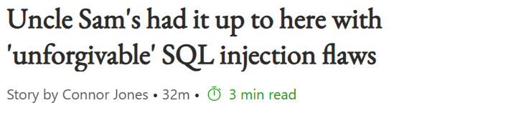
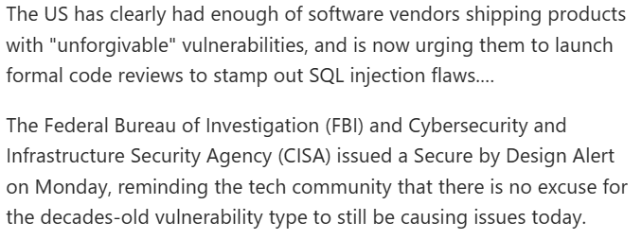
Secure SQL – Easy to do!
Notes:
https://www.msn.com/en-us/news/technology/uncle-sam-s-had-it-up-to-here-with-unforgivable-sql-injection-flaws/ar-BB1kzyo3?ocid=msedgntp&pc=HCTS&cvid=d162b717c4f9424fb3b8fd03efb0edbe&ei=74

Slide 62
Secure SQL – Easy to do!
Parameterized Queries
ORM
Welcome-list on Non-Parameterized values
Welcome-list on ALL values
Use Infrastructure!

Slide 63
Summary

Slide 64
PREVENT - SFS Principles
#1 Welcome Lists!
Priority/Privacy/Permissions
Reporting & logging
Easy to use securely
Verify
Errors & exceptions
Neat code
Trust Boundaries

Slide 65
PREVENT - SFS Principles
#1 Welcome Lists!
Priority/Privacy/Permissions
Reporting & logging
Easy to use securely
Verify
Errors & exceptions
Neat code
Trust Boundaries
Thank You!
SecureFromScratch.com

Slide 66
Part 5 (Bonus): Preventing change

Slide 67
PREVENT – Easy To Use Safely
Good, but not perfect
...
sandbox = Sandbox('public')
image_path = sandbox.join('public', color, imgName);
# was os.path.join('public', color, imgName)
return FileResponse(image_path)
Notes:
Can still access “green”, “rat.webp”, “ids/john_doe.webp”, “funday/programmers_team.webp”

Slide 68
Nothing’s Perfect?
Previous secure code was “ok”, but not perfect.
User’s can still send “green” or “rat.webp”
What if we need to prevent user “invented” values?

Slide 69
LAB: Implement missing logic
10 min
Change myanimal so only the valid values are accepted
color can be blue, yellow, pink
imgName can be only what was sent in /api/animals
IMPORTANT: Do not look in the spoilers folder!

Slide 70
Accepting only valid values
How did you do it?
(code walkthrough)

Slide 71
Signed Values
We want the browser to only send values we gave it.
Solution: Sign those values
(We are the only ones with the signing key)
i.e.
‘lion.webp’+‘..’+sign(‘lion.webp’) => `lion.webp..ab73c83a5`
verify(`lion.webp..ab73c83a5`.split(‘..’))

